Slide 1

Department of Computer Science & Engineering Artificial Intelligence & Machine Learning
A.P. Shah Institute of Technology
G.B.Road, Kasarvadavli, Thane(W), Mumbai-400615
UNIVERSITY OF MUMBAI
Academic Year 2022-2023

Slide 2
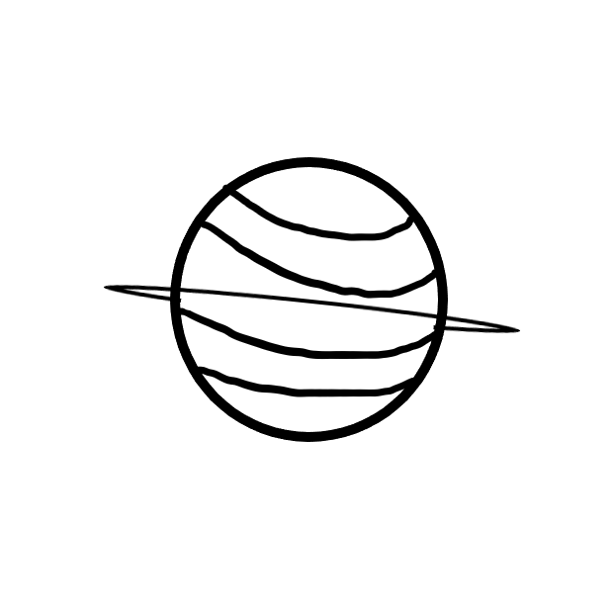





PREDICTOR
Computer Science & Engineering
Artificial Intelligence and Machine Learning
By-
Kapil Surve (21106018)
Sridev Nayak (21106059)
Shreyash Wadalkar(211060)
Under the Guidance of
Prof. Mahesh Pawaskar

Slide 3
Index:
Introduction
Objectives
Literature Survey
Block Diagram
Tools/Softwares, Languages used
Implementation
Conclusion
References

Slide 4
Introduction
At least once in a life time you must have read kundali or birthchart .To read a kundali we need a Jyotisha/Astrologer .They can easily give insights on your future and past by reading your birth chart and can give accurate predictions so here we go then Introducing Predictor . This Project is Based on Vedic Astrological Calculations for making future predictions .
You can know the future instances with help of this birth chart reader

Slide 5
Objectives
To Provide User an Unbiased Kundali Predictions
Analyzing Birth Chart for Possible Events
One can find Education Choices
One can get suggestions for his problems
One can know about his True Self
One can know about their Soul mate
Generated Prediction Report on your Job ,Income and Opportunities.
Provides you with predictions of your Family,Friends and Martial ConditionS

Slide 6
Literature Survey
Sr no | Title | Author | Description
1. | Predictive role of case based reasoning for astrological predictions about profession: system modeling approach. | Rishi, O. P., and Neelam Chaplot | This paper describes the research in the field of astrology using case based reasoning method of artificial intelligence. Most typical aspect of astrology is the rules on which prediction is done in this science. Rules are defined by experienced persons in the field of astrology by identifying the similarity between the past cases which they have encountered.
2. | Analysis of astrology and scientific calculation through orbital period | Sharma, Harsh, Naveen Rao, and Mohit Sharma | Indian Astrology is old as Indian civilization and gets developed time to time. From so long time (B.C.) Indian civilization had unit like degree and minute (as Ansha & Kala) to measure the angular distances. But in present time people connect astrology only with the spirituality not with science. . This paper describe the calculations which astrology use to show planetary movement and those scientific calculations which prove them.

Slide 7
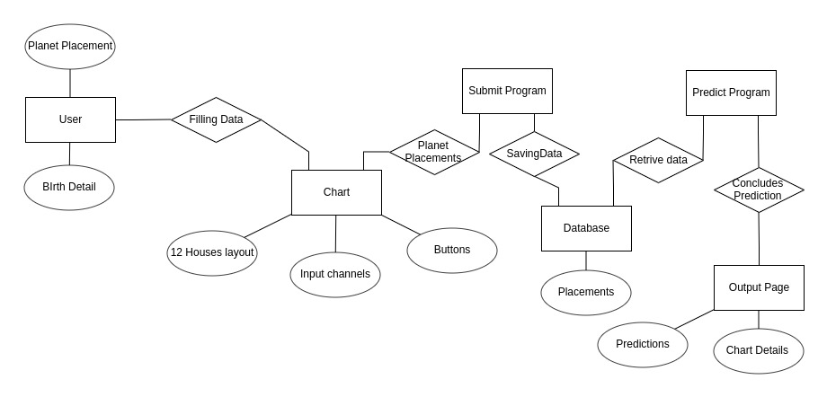
Block Diagram

Slide 8





Tools & Software Used
HTML
CSS
JAVASCRIPT
VSCODE
MYSQL

Slide 9

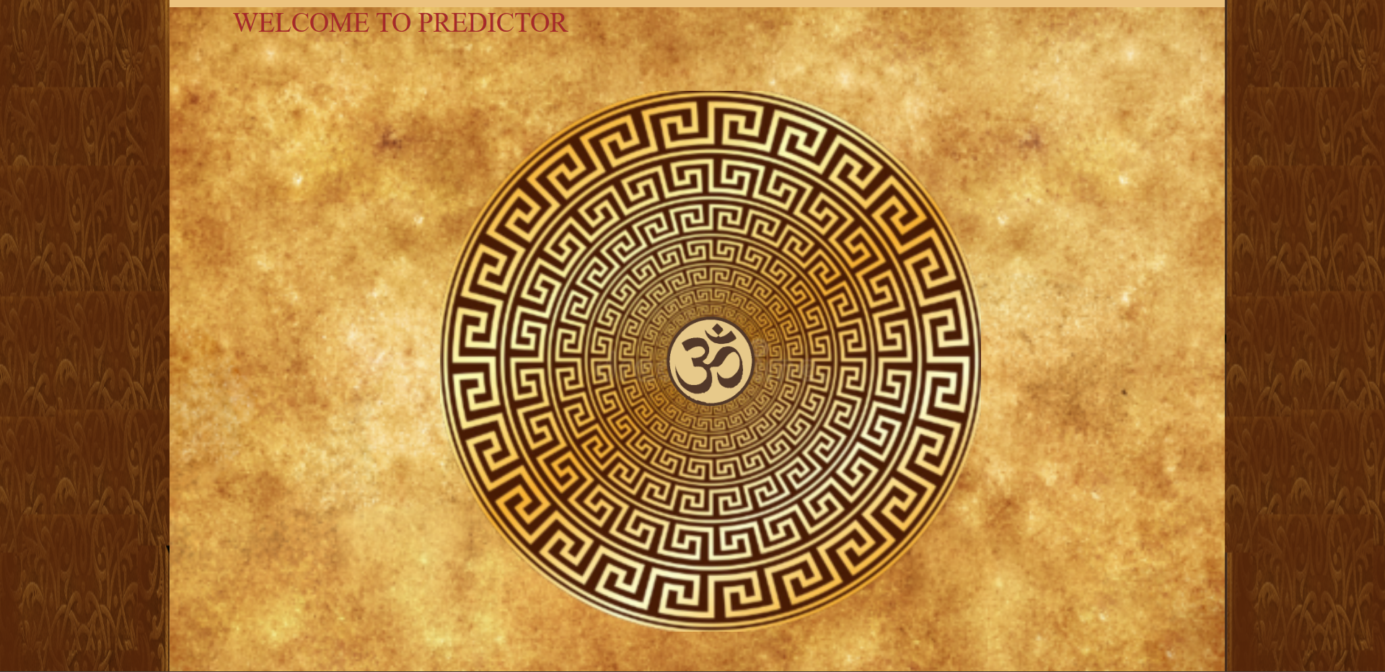
Implementation
Access Page:

Slide 10
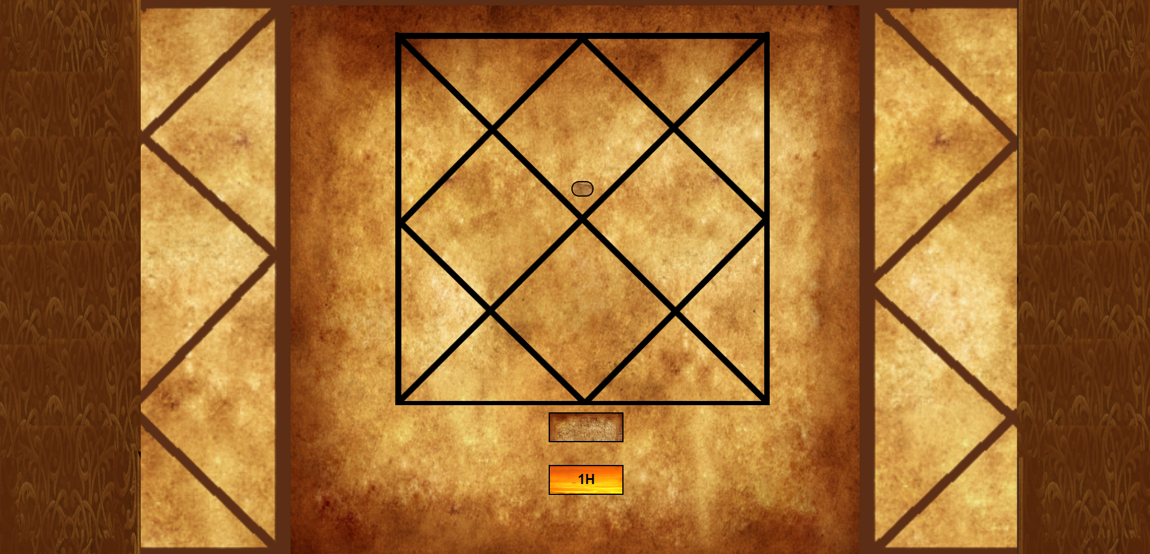
Implementation
Chart Page:

Slide 11

Implementation
Report Page:

Slide 12
Conclusion
We have fairly proceded with frontend about 40 percent Of front end
is done.
Will be planning to complete it in next 3 week .
As of now Implementing Logic with Database is a challenge we are facing
Which will take a bit lot of stress to study on the process of creating this
Project
Will be planning to create our Database in coming weeks.

Slide 13
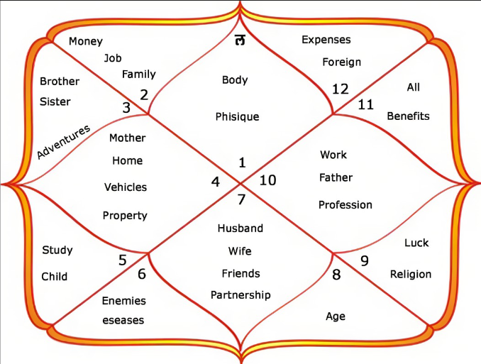
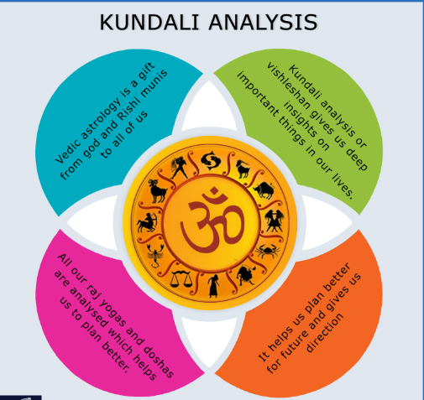
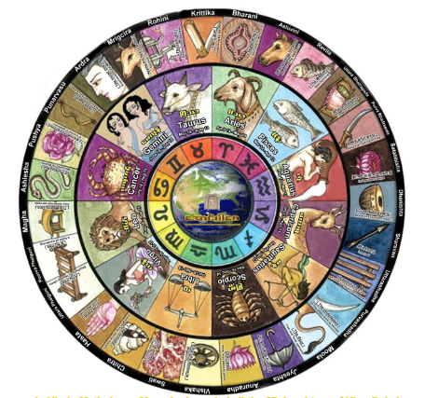
References
Websites : https://www.astroyogi.com/kundli
https://www.prokerala.com/astrology/birth-chart/
Books:
RD.Jyotishshastra

